Slide 1
RESTAURANT RESERVATION SYSTEM
Anis Nur Hajar binti Ahmad Rizal
Amir Khaidir bin Adzeman
Muhammad Afif Mirza bin Mohd Farid
Nur Aida Farahanie binti Ahmad

Slide 2
OVERVIEW
To develop a system that can ensure the optimal, convenient and efficient table reservation system
A web-based application for a restaurant
RRS allows customers to reserve their table based on their specific date and time which they can also update the reservation

Slide 3
INTENDED AUDIENCE
Business Owner
System Vendors (Team RRS)

Slide 4
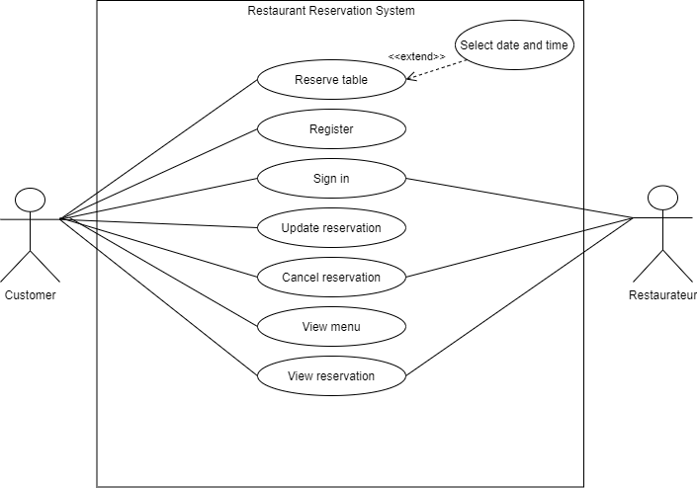
USE CASE

Slide 5
NON-FUNCTIONAL REQUIREMENTS
Performance requirements
Safety requirements
Security requirements
Software quality attributes
Availability
Usability

Slide 6
CONT. WITH UI DEMO☺

